Slide 1

Athenian Academy
Title l Annual Meeting
2025-2026

Slide 2


Data Resources/Consider
Comprehensive Needs Assessment
School Improvement Plan
PM3 24-25 Data

Slide 3


All About Title l
Title I is the largest federal assistance program for our nation’s schools.
The program serves 99 schools in Pinellas County including eligible students in 39 non-public schools.
The Title l goal is that every student achieves high levels of academic proficiency.

Slide 4

Athenian Academy
9/30/2025
4:30 PM – 5:00 PM
Cafeteria – 2289 N. Hercules Ave., Clearwater
June Roper- Principal
2025-26 Title l Annual Parent Meeting

Slide 5

Title I Funding Process
2. Florida Department of Education
1. Federal Government
4. Athenian Academy
3. Pinellas County Schools
Notes:
The Florida Department of Education receives funds from the federal government. Districts receive Title I funds from Department of Education, and the school district distributes these funds to schools based on the percentage of children eligible for free/reduced price lunch; however, students do not have to be from low-income families to receive help.

Slide 6


Slide 7


Continuing To Grow!
95% of 7th grade students passed the Civics EOC
6th grade ELA outperformed the state by 11% and the district by 8% (level 3 and above)
7th grade ELA outperformed the state by 21% and the district by 16% (level 3 and above)
Grades 4-7 performed at the same level as the state and district in our first online state writing assessment.
7th grade math outperformed the state by 16% and the district by 36%.
1st and 2nd grade students who took the STAR Reading assessment increased from 50% to 61% (percentage of students who scored at or above the district benchmark proficiency level).
K-2 students who took the STAR math assessment increased from 49.6% to 64.5% (students who scored at or above the 35% typical student growth percentile).
Notes:
Based on the FAST data and school grades, there is a lot to celebrate!!
How did your Title I Resources support or enhance the work that you were able to get done?

Slide 8

Title I Schoolwide Budget
Athenian Academy is provided $49,400.00 to pay for supplemental resources and programs for increased student achievement.
Athenian Academy will use these funds to support the MTSS role and, the continued additional support from a paraprofessional

Slide 9
School’s Title I Parent & Family Engagement 2025-26 Budget
Total Allocation - $5,300.00
Technology Related Supplies- $500.00 (9%)
Consultants for Parent Workshops - $3,000.00 (57%)
Instructional Materials- $500.00 (9%)
Contracted Services- $950.00 (18%)
Snacks/Food - $350.00 (7%)

Slide 10

Parent’s Right to Know
As a parent of a student attending a Pinellas County Charter School, you have the right to…
Be
Be provided information on your child’s level of achievement on assessments in Reading/Language Arts, Writing, Mathematics, and Science.
Request and receive information on the qualifications of your child’s teacher and supplemental personnel working with your child.
Be
Be notified of non-highly qualified or out-of-field teachers at the school.
Be
Be informed if your child is taught by a non-highly qualified teacher for four or more consecutive weeks.

Slide 11
Working Together for Student Success
School
School Improvement Plan (SIP)
Title
Title I Schoolwide Plan
Parent
Parent and Family Engagement Plan
School
School-Parent-Student Compact
Title l is now included as a part of the School Improvement Plan
Notes:
As a Title I parent you have the right to be involved in the development of the following plans and documents for our school which can be found on our website (insert website) to view as well as in the Parent Station located (insert location here).
Our school’s Title I Parent Station is located (insert location or photo of Title I Parent Station (front office and on the webpage). Please include photo as part of the evidence monitoring.
You will find a copy of our School Improvement Plan, Title I Schoolwide Plan, School’s PFEP, the School District’s PFEP, Parent’s Right to Know Memo, Upcoming Events, Compact, (insert other documents at your station)
School Improvement Plan (SIP)
Parent and Family Engagement Plan
Title I Schoolwide Plan
School-Parent-Student Compact

Slide 12

Parent-School-Student Compact
The purpose of the compact is to foster student achievement. By signing the Parent-School-Student Compact, (Insert name of school here), teachers, staff, parents and students agree to work together to share the responsibility of helping students meet or exceed state, district and school academic goals.
The Parent-School-Student Compact is updated every year to include parent, student, teacher, and staff input. Parent, student, teacher and staff comments are welcome at any time during the year.
Please review and sign your child’s Compact if you have
not do so already.
Our goal is to receive 100% signed compacts!
Notes:
At the elementary level, school compacts are used as a progress monitoring tool through the year during parent teacher conferences.

Slide 13
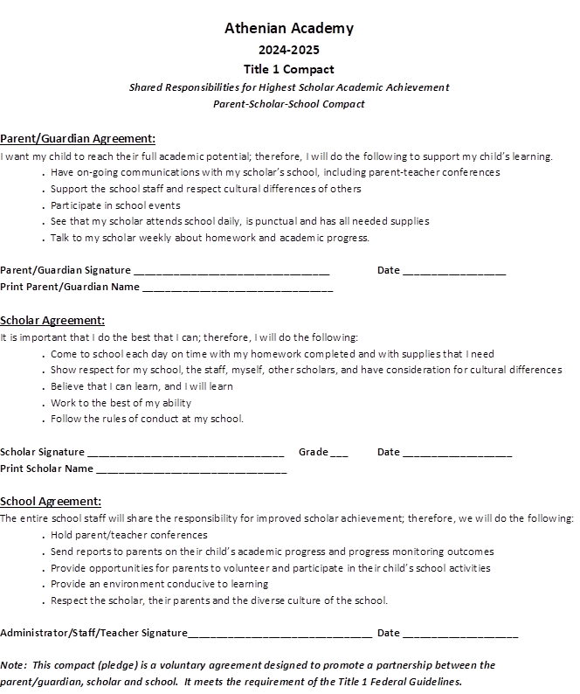
Athenian Academy 2025-2026 Compact

Slide 14

Parent and Family Engagement Plan (PFEP)
The PFEP Sections include information about the following:
  Parent meeting to increase student achievement
  Staff trainings for engaging parents
  Communication methods between home and school
  Accessibility for parents
  Coordinating with other Federal Programs
  To access the full LEA PFEP, please visit
  www.pcsb.org/titleone
Notes:
Provide information on the specific committees that parents can be involved. Include the purpose, date and time of meetings.
Explain the PFEP and its purpose.
Consider the evidence related Title I Crate, Sample of Evidence,

Slide 15

Florida Benchmark For Excellent Student Thinking Standards (B.E.S.T). You may read more information by visiting, www.fldoe.org.
Notes:
All curriculum, instruction and assessments are based on student-centered expectations.

Slide 16

School’s Curriculum
Florida Benchmark For Excellent Student Thinking Standards (B.E.S.T) form the framework of everything taught at school.
Core Curriculum (McGraw Hill)
  Reading
  Mathematics
  Writing
  Science
  Civics
Notes:
This slide is optional if this will be discussed with classroom teacher
School’s Curriculum
Describe and explain the curriculum (Specific names of texts)

Slide 17
Florida End of Course (EOC)
Assessments
(Algebra 1, Civics, Spanish, Greek)
To learn more about state assessments visit the Florida Department of Education’s website, fldoe.org/accountability/assessments.
Notes:
This slide is only required, if it applies.

Slide 18

  School Report Cards
  School Grade and Overview
  Population and Enrollment
  Assessments – Academic Achievement, Growth, and Population
  Assessments – English Language Learners
  Graduation and Beyond
  Educator Qualifications and Equity
  Long-Term Goals and Interim Progress
  Accelerated Course Enrollment
  Per-Pupil Expenditures
  National Data
  Available online at https://edudata.fldoe.org/ or Front Office

Slide 19

10/13 – No School For Students
10/17 – Fall Into Fun (Trunk-R-Treat)
11/12 – Great American Teach-In
11/18 – Picture Retakes
11/24-11/28 – Thanksgiving Break
12/10 – Holiday Performance – Countryside High School

Slide 20

Parent Advisory Council (PAC)
The District has a Parent and Family Engagement Plan. The summary of the plan is in the Title I School & Family Partnership Overview.
You may access the full plan at www.pcsb.org/titleone
The Parent Advisory Council (PAC) is responsible for reviewing and revising the District PFEP.
PAC will meet virtually or in person with the district’s Title I staff.
Each school is committed to having at least one member representative in PAC.
PAC meets twice a year, if you are interested in representing our school please notify, Insert contact person
Notes:
Please add your PAC representative in slide and share with your Title I Specialist.
https://forms.office.com/r/r5daaMTENE\

Slide 21

Thank you for your time!

Slide 22
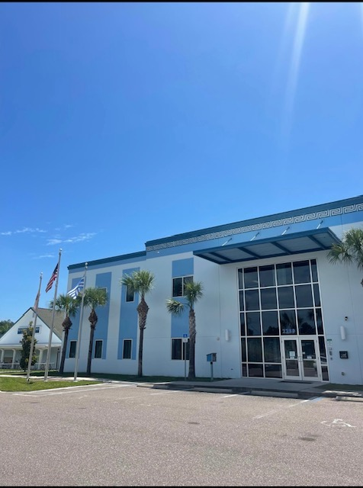
Contact Us
Mrs. Roper
2289 N. Hercules Ave
Clearwater, FL 33763
727-298-2718
c.roperj@pcsb.org
Notes:
Please insert the school contact information and the best way to reach out to the school.

Slide 23


Slide 24
Your Input is valuable. Please take a moment to fill out the survey.
﻿
﻿
﻿
﻿
﻿
﻿

